Slide 1
Mini Project 2 Loan Application Status Prediction
Submitted By-
Anjandeep Kaur

Slide 2
Problem Statement
This dataset includes details of applicants who have applied for loan. The dataset includes details like credit history, loan amount, their income, dependents etc.
IndependentVariables: Loan_ID, Gender, Married, Dependents, Education, Self_Employed, ApplicantIncome, CoapplicantIncome, Loan_Amount, Loan_Amount_Term, Credit History, Property_Area
Dependent Variable (Target Variable): Loan_Status
Objective : You have to build a model that can predict whether the loan of the applicant will be approved or not on the basis of the details provided in the dataset.

Slide 3
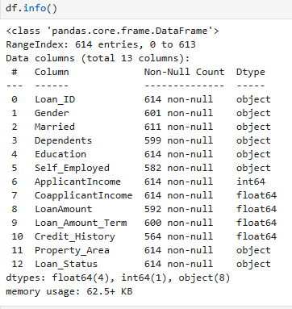
Dataset Information
We Have 13 features in this Dataset.
We have dataset including Object, Integer And
Float dataset.
We Have Total 614 Rows.
We Do Not Have Any Null Values.

Slide 4
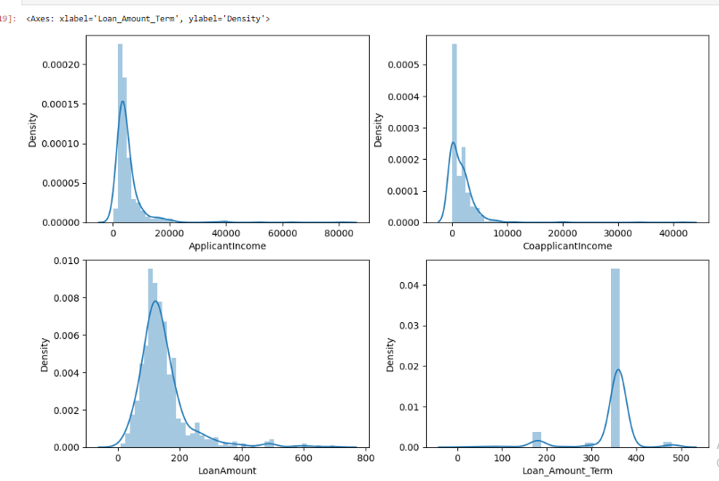
Data Visualization
Distribution Of Continuous Variables :

Slide 5
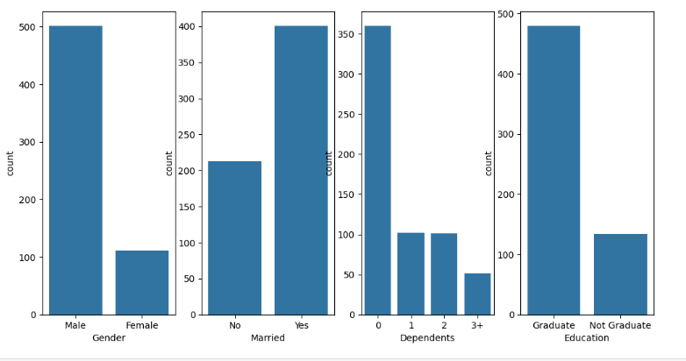
Distribution Of Categorical Variables:

Slide 6
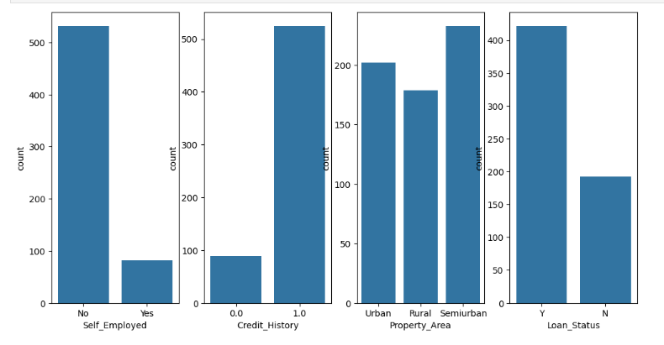

Slide 7
Data Preprocessing
Perform Feature Encoding On Categorical Variables Using Label Encoding.
Scale CoapplicantIncome using power transform yeo-johnson
Handling Outliers : Plotting Boxplot Loan_Amount_Term and Creidt_History shows Outliers.
Use z core Method To Remove The Outliers.
Scale data Using Max Min Scaler.

Slide 8
Model Selection
Algorithms Tested :
Logistic Regression
Decision Tree Classifier
K Nearest Neighbour Classifier
Random Forest Classifier
Cross Validation : Performed 5-fold cross validation to prevent overfitting
Hyper parameter Tuning : Applied Grid Search CV to the best algorithm

Slide 9
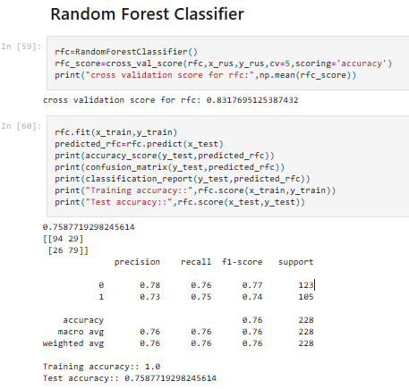
Model Evaluation and Metrics
Evaluation Metrics
Precision
Recall
F1 Score
Support
Best Performing Model
Random Forest with accuracy of 76%.

Slide 10
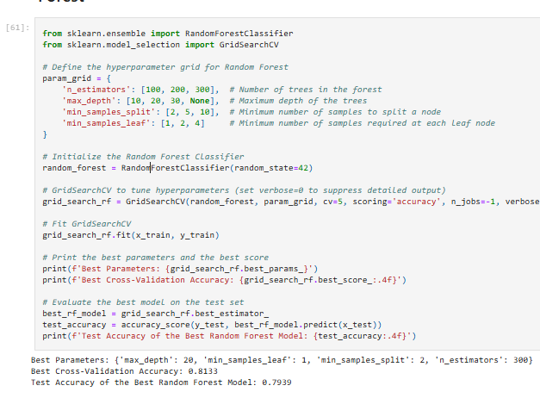
Hyper Parameter Tuning
Using Grid Search CV We Applied Hyper parameter Tuning And Improved The Accuracy 79.39%.

Slide 11
Conclusion And Future Scope
Conclusion
Using The Medical Insurance Dataset In-depth Data Analysis Conducted.
Multiple Classification Models Were Trained And Random Forest Perform The Best.
Future Scope
Implement more advanced models like Neural Networks
Testing with additional datasets or more features.

